Slide 1
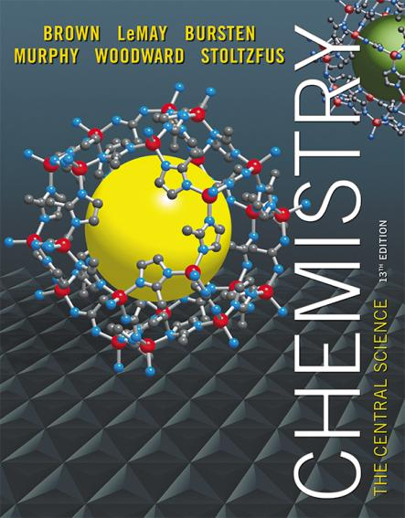
Lecture Presentation
Chapter 10 Gases

Slide 2
Characteristics of Gases
Physical properties of gases are all similar.
Composed mainly of nonmetallic elements with simple formulas and low molar masses.
Unlike liquids and solids, gases
expand to fill their containers.
are highly compressible.
have extremely low densities.
Two or more gases form a homogeneous mixture.

Slide 3
Properties Which Define the State of a Gas Sample
Temperature
Pressure
Volume
Amount of gas, usually expressed as number of moles
Having already discussed three of these, we need to define pressure.

Slide 4
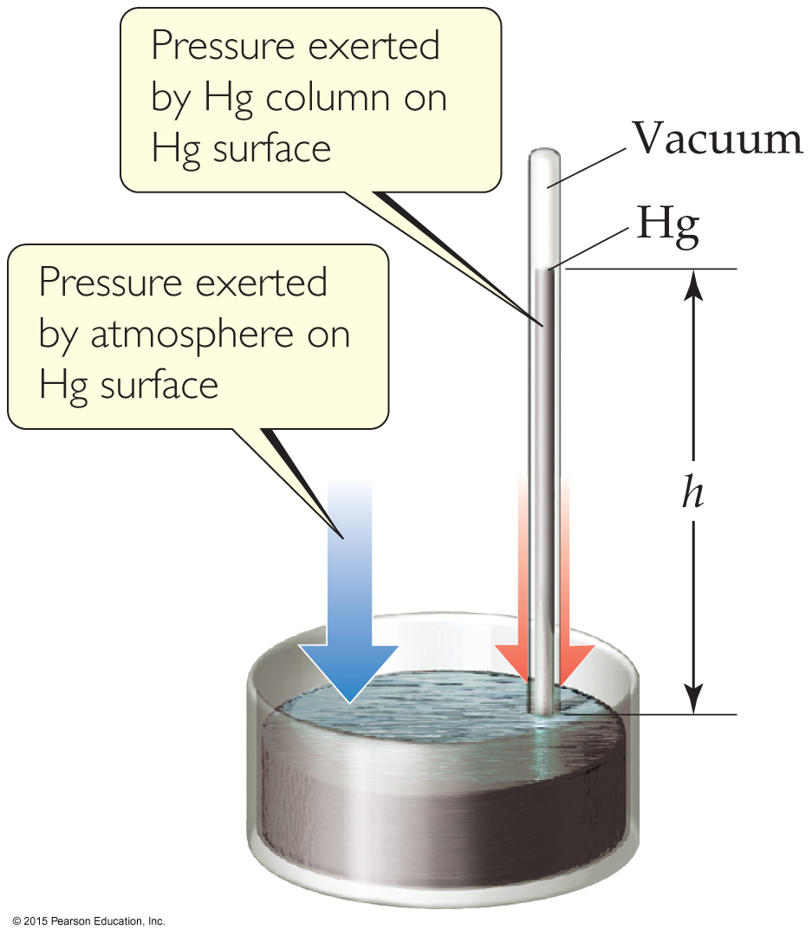
Units of Pressure
Pascals: 1 Pa = 1 N/m² (SI unit of pressure)
Bar: 1 bar = 10⁵ Pa = 100 kPa
mm Hg or torr: These units are literally the difference in the heights measured in mm of two connected columns of mercury, as in the barometer in the figure.
Atmosphere:
1.00 atm = 760 torr = 760 mm Hg = 101.325 kPa

Slide 5
Standard Pressure
Normal atmospheric pressure at sea level is referred to as standard atmospheric pressure.
It is equal to
1.00 atm.
760 torr (760 mmHg).
101.325 kPa.

Slide 6
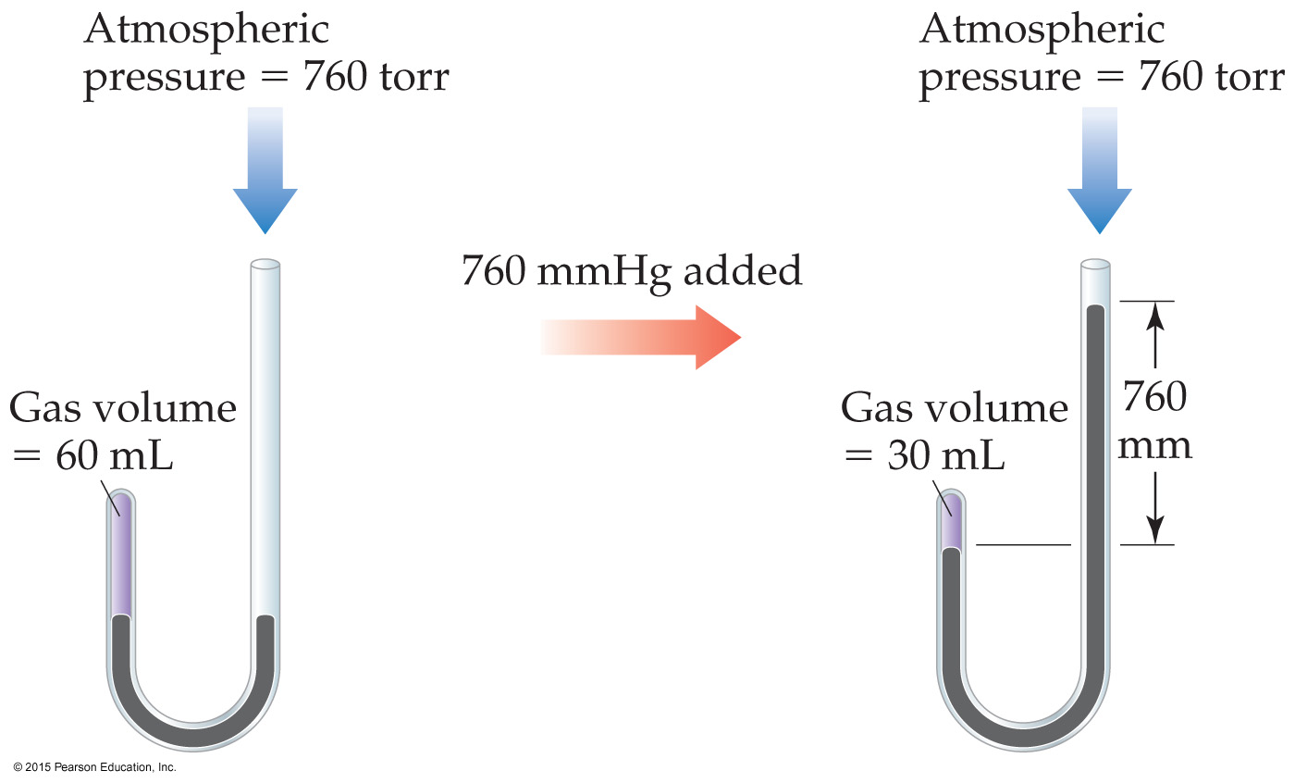
Boyle’s Law
The volume of a fixed quantity of gas at constant temperature is inversely proportional to the pressure.

Slide 7
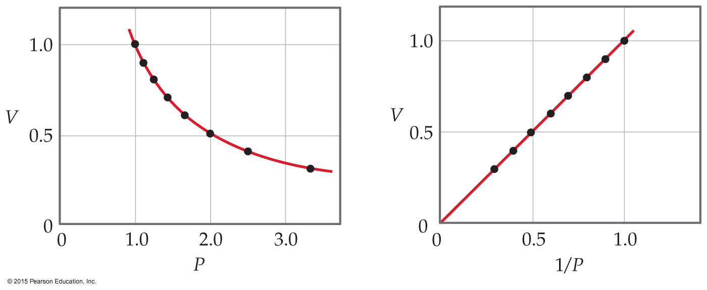
Mathematical Relationships of Boyle’s Law
PV = a constant
This means, if we compare two conditions: P₁V₁ = P₂V₂.
Also, if we make a graph of V vs. P, it will not be linear. However, a graph of V vs. 1/P will result in a linear relationship!

Slide 8
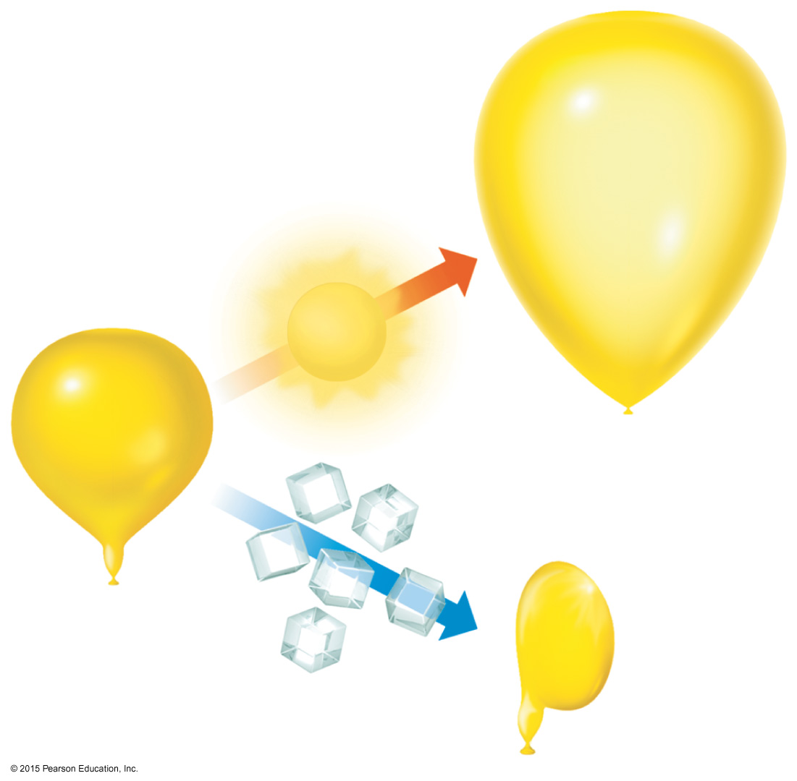
Charles’s Law
The volume of a fixed amount of gas at constant pressure is directly proportional to its absolute temperature.

Slide 9
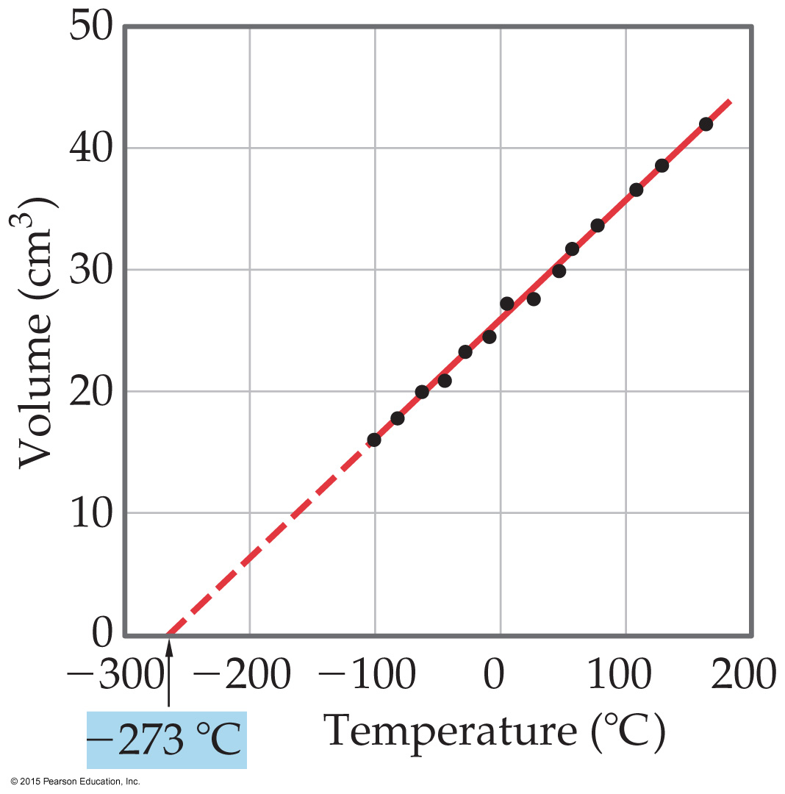
Mathematical Relationships of Charles’s Law
V = constant × T
This means, if we compare two conditions: V₁/T₁ = V₂/T₂.
Also, if we make a graph of V vs. T, it will be linear.

Slide 10
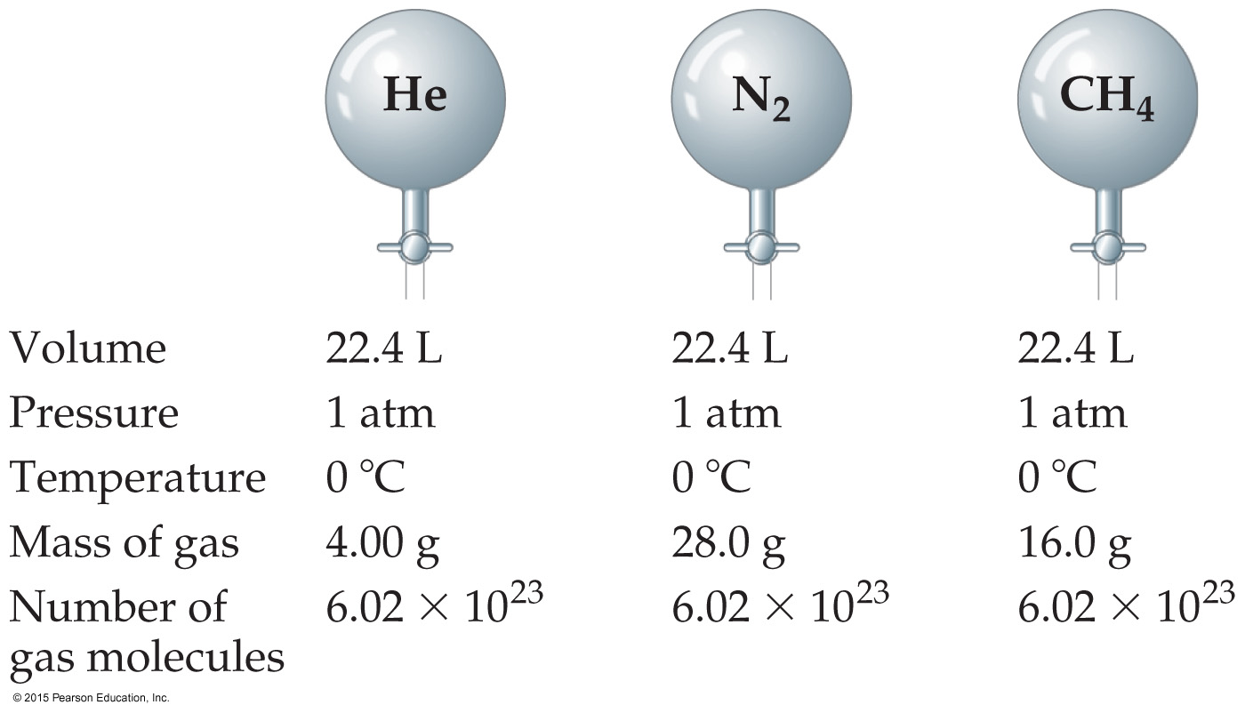
Avogadro’s Law
The volume of a gas at constant temperature and pressure is directly proportional to the number of moles of the gas.
Also, at STP, one mole of gas occupies 22.4 L.
Mathematically: V = constant × n, or V₁/n₁ = V₂/n₂

Slide 11
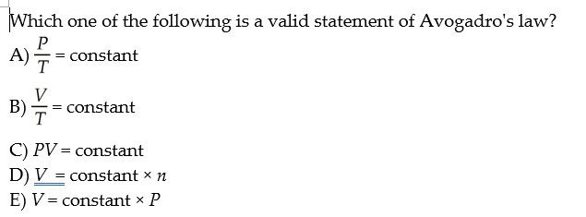
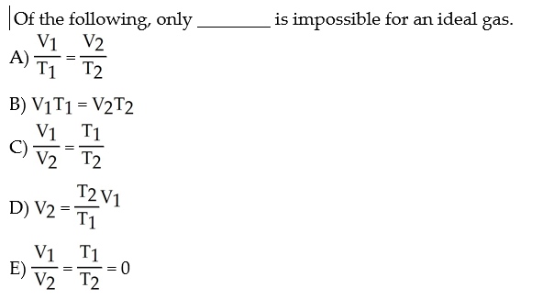

Slide 12
Ideal-Gas Equation
So far we’ve seen that
V ∝ 1/P (Boyle’s law).
V ∝ T (Charles’s law).
V ∝ n (Avogadro’s law).
Combining these, we get
nT
P
V ∝
Finally, to make it an equality, we use a constant of proportionality (R) and reorganize; this gives the Ideal-Gas Equation: PV = nRT.

Slide 13
Density of Gases
If we divide both sides of the ideal-gas equation by V and by RT, we get
n/V = P/RT.
Also: moles × molecular mass = mass
n × M = m.
If we multiply both sides by M, we get
m/V = MP/RT
and m/V is density, d; the result is:
d = MP/RT.

Slide 14
Density & Molar Mass of a Gas
To recap:
One needs to know only the molecular mass, the pressure, and the temperature to calculate the density of a gas.
d = MP/RT
Also, if we know the mass, volume, and temperature of a gas, we can find its molar mass.
M = mRT/PV

Slide 15
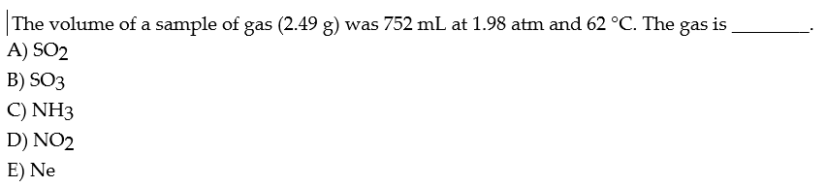
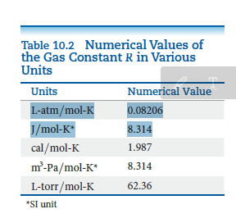
D
M = mRT/PV
R= 0.08206 L-atm/mol-K

Slide 16
Volume and Chemical Reactions
The balanced equation tells us relative amounts of moles in a reaction, whether the compared materials are products or reactants.
PV = nRT
So, we can relate volume for gases, as well.
For example: use (PV = nRT) for substance A to get moles A; use the mole ratio from the balanced equation to get moles B; and (PV = nRT) for substance B to get volume of B.

Slide 17
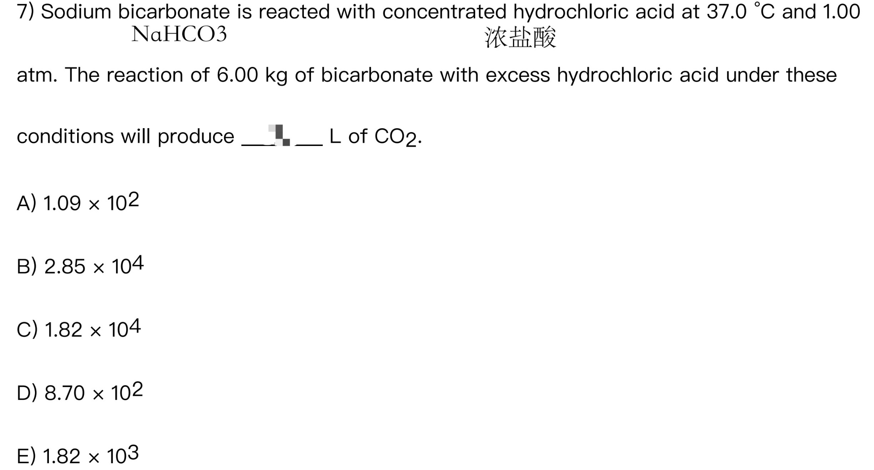
V = nRT/P

Slide 18
Dalton’s Law of Partial Pressures
If two gases that don’t react are combined in a container, they act as if they are alone in the container.
The total pressure of a mixture of gases equals the sum of the pressures that each would exert if it were present alone.
In other words,
P_{total} = p₁ + p₂ + p₃ + …

Slide 19
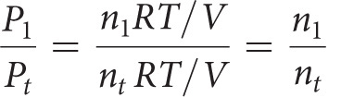
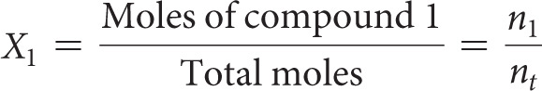
Mole Fraction
Because each gas in a mixture acts as if it is alone, we can relate amount in a mixture to partial pressures:
That ratio of moles of a substance to total moles is called the mole fraction, χ.

Slide 20
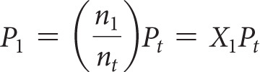
Pressure and Mole Fraction
The end result is

Slide 21
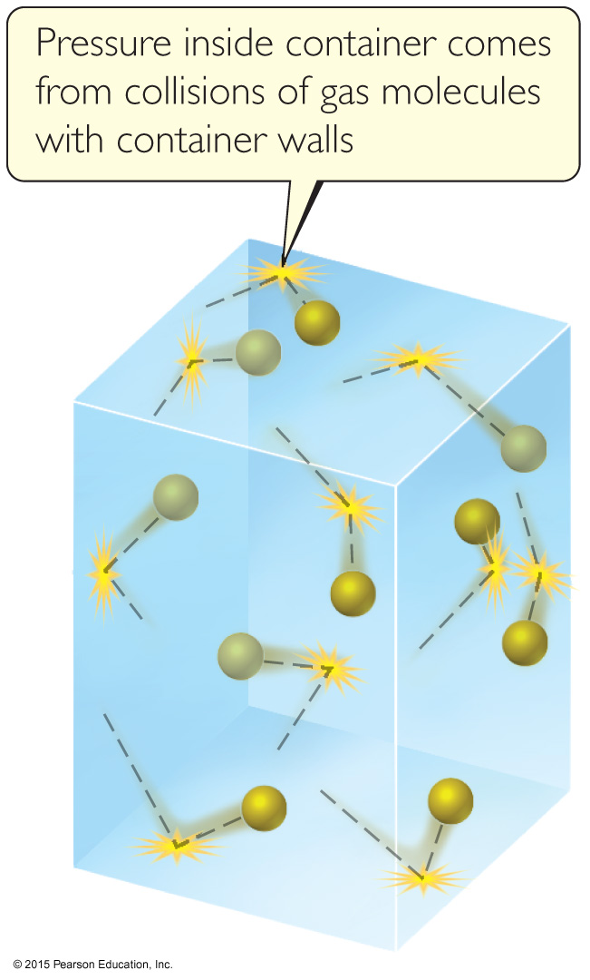
Kinetic-Molecular Theory
Laws tell us what happens in nature. Each of the gas laws we have discussed tell us what is observed under certain conditions.
Why are these laws observed? We will discuss a theory to explain our observations.

Slide 22
Main Tenets of Kinetic-Molecular Theory
Gases consist of large numbers of molecules that are in continuous, random motion.
The combined volume of all the molecules of the gas is negligible relative to the total volume in which the gas is contained.
Attractive and repulsive forces between gas molecules are negligible.

Slide 23
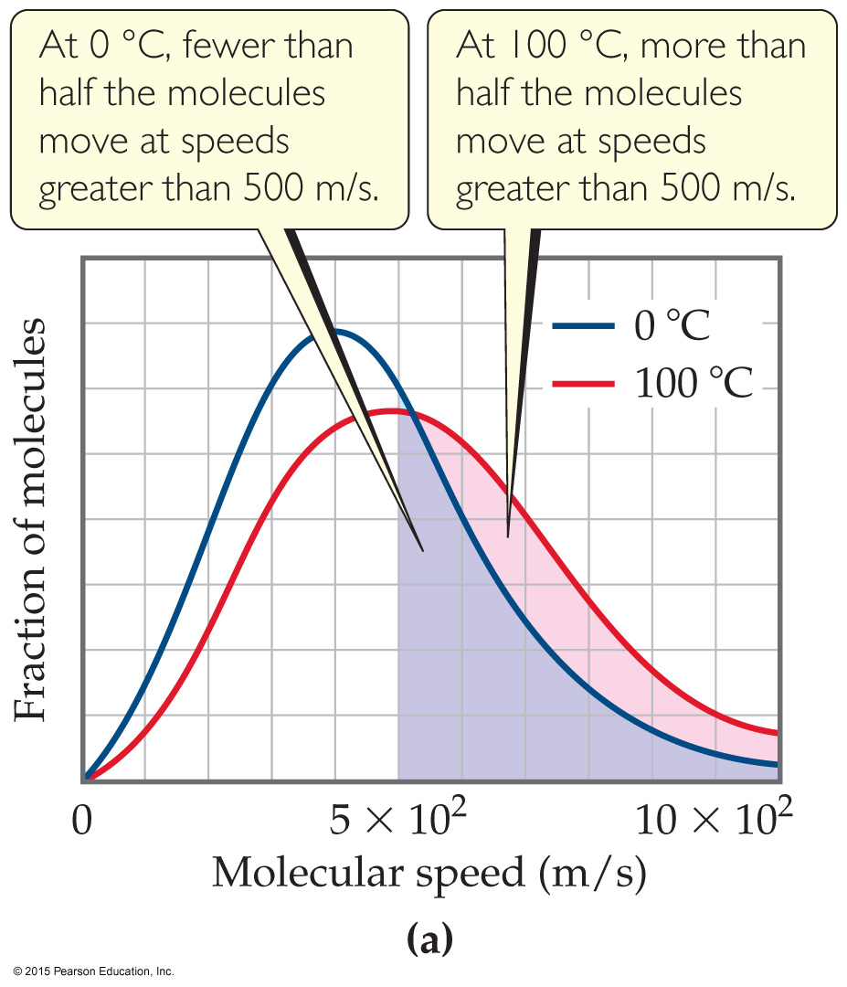
Main Tenets of Kinetic-Molecular Theory
Energy can be transferred between molecules during collisions, but the average kinetic energy of the molecules does not change with time, as long as the temperature of the gas remains constant.
The average kinetic energy of the molecules is proportional to the absolute temperature.

Slide 24
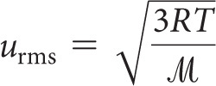
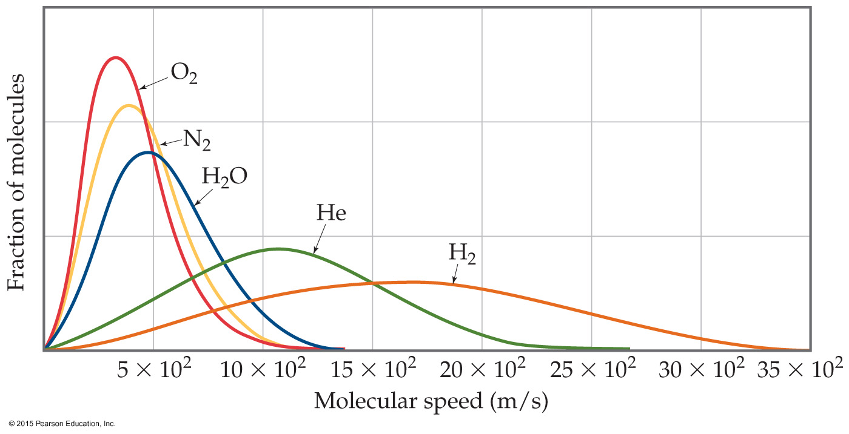
u_{rms} and Molecular Mass
At any given temperature, the average kinetic energy of molecules is the same.
So, ½ m (u_{rms})² is the same for two gases at the same temperature.
If a gas has a low mass, its speed will be greater than for a heavier molecule.

Slide 25
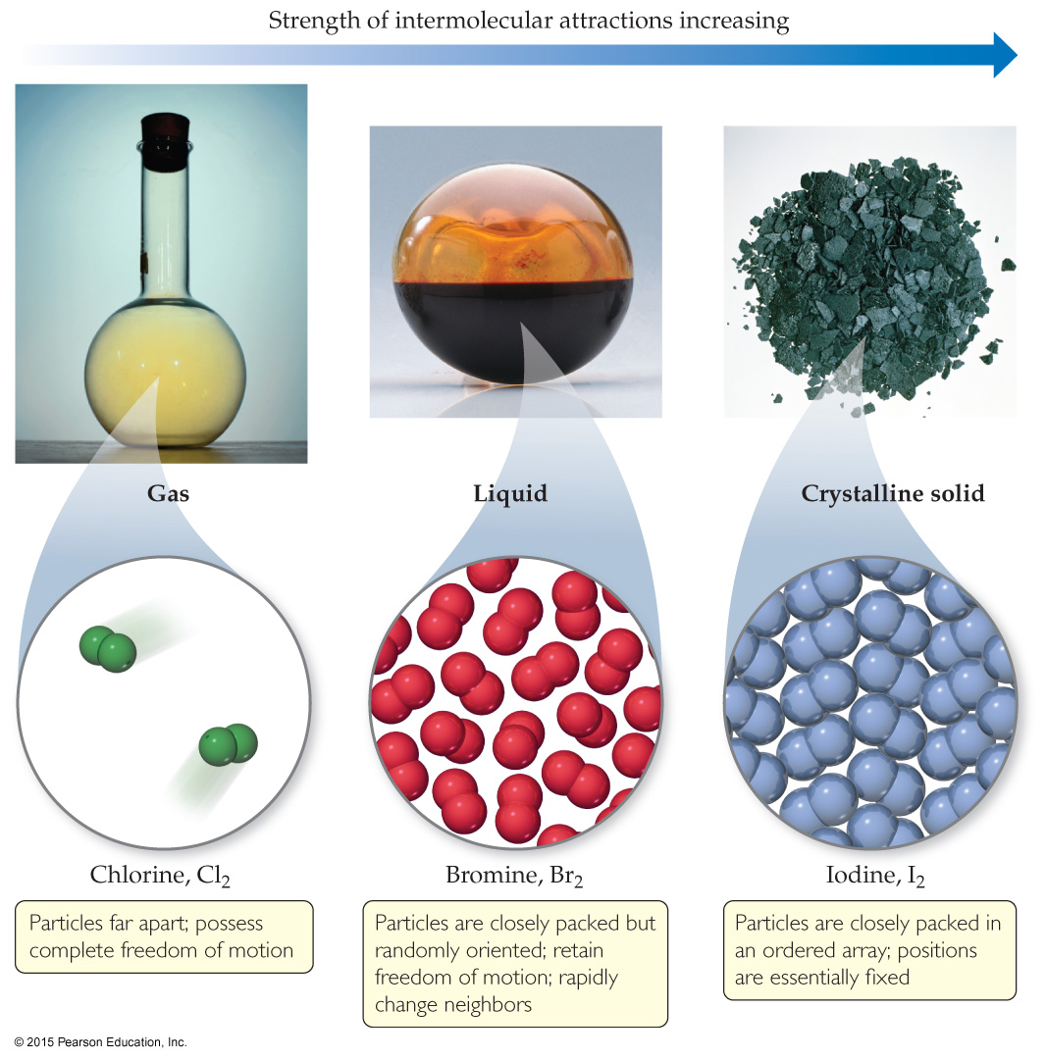
States of Matter
The fundamental difference between states of matter is the strength of the intermolecular forces of attraction.
Stronger forces bring molecules closer together.
Solids and liquids are referred to as the condensed phases.

Slide 26
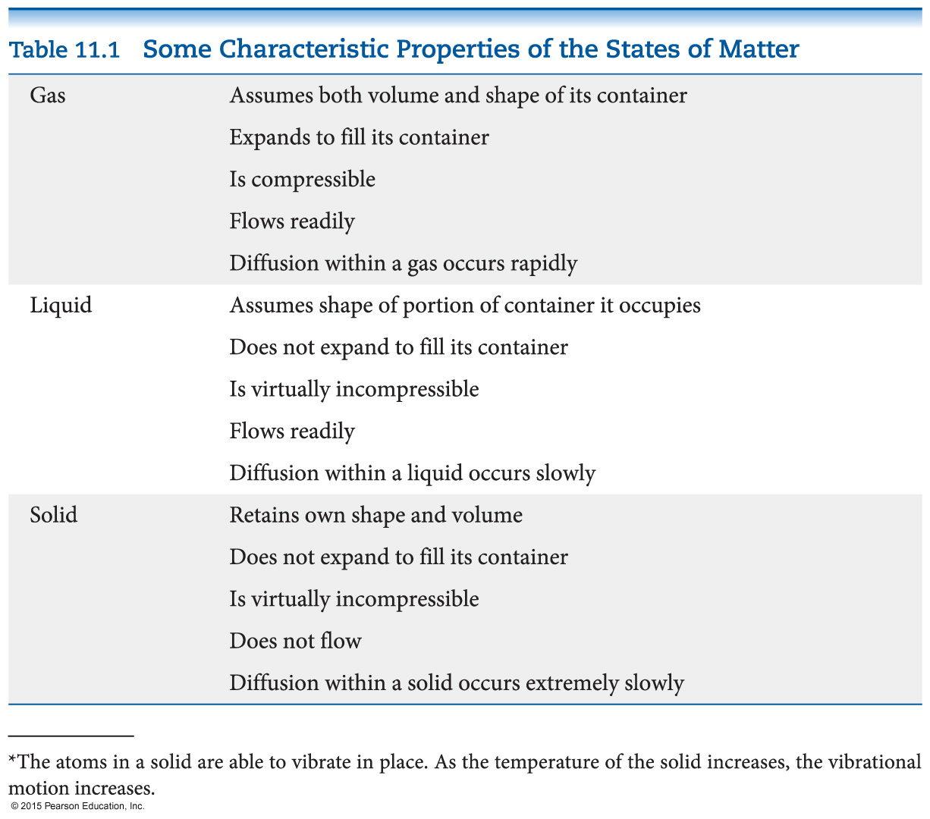
Differences in the States of Matter

Slide 27
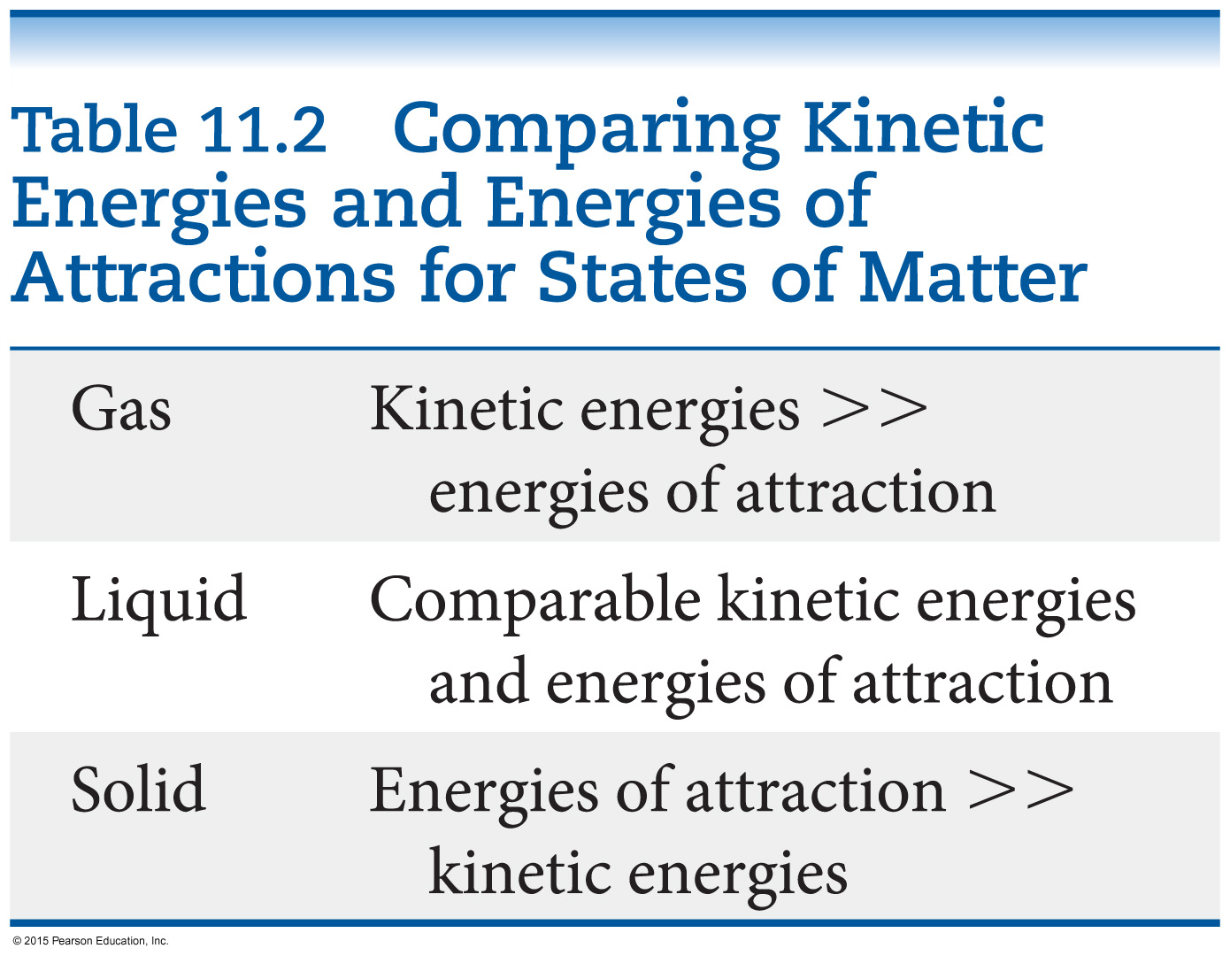
Which State of Matter?
The answer to this question largely relies on the
balance between the kinetic energies of the particles.
interparticle energies of attraction.

Slide 28
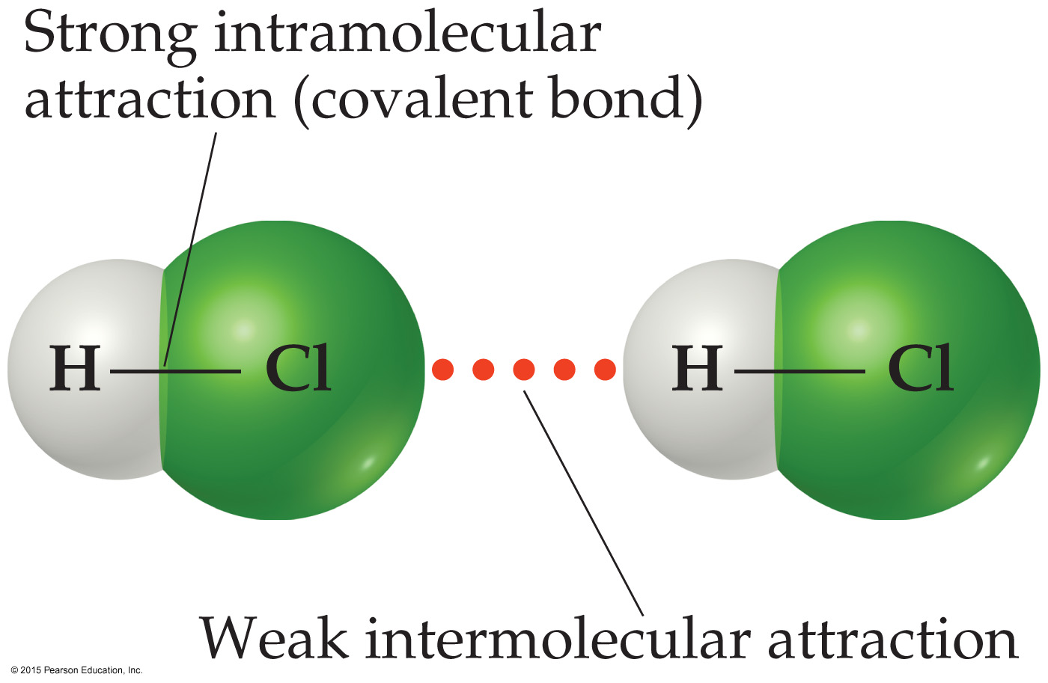
Intermolecular Forces
The attractions between molecules are not nearly as strong as the intramolecular attractions (bonds) that hold compounds together.
Many physical properties reflect intermolecular forces, like boiling points, melting points, viscosity, surface tension, and capillary action.

Slide 29
Types of Intermolecular Force
Weakest to strongest forces:
dispersion forces (or London dispersion forces)
dipole–dipole forces
hydrogen bonding (a special dipole–dipole force)
ion–dipole forces
Note: The first two types are also referred to collectively as van der Waals forces.

Slide 30
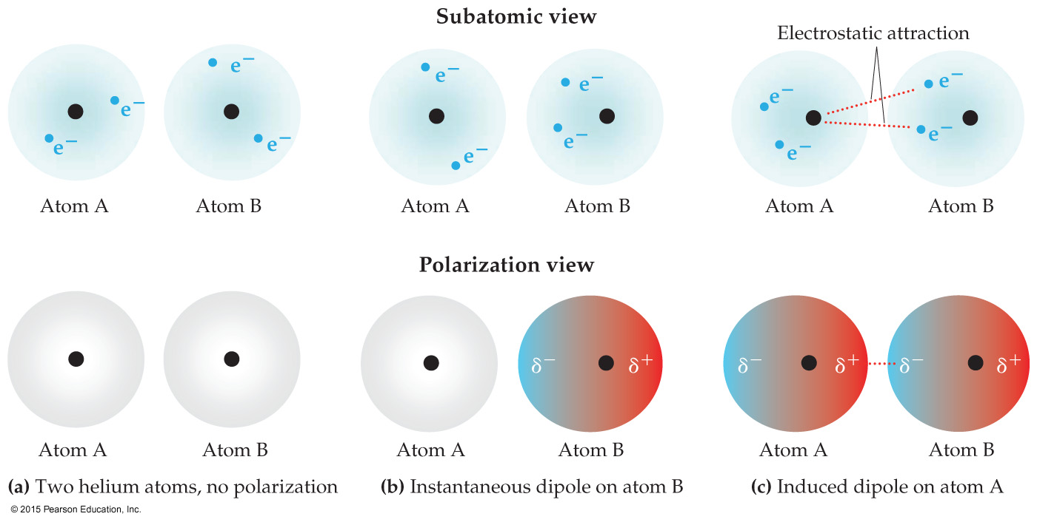
Dispersion Forces
The figure below shows how a nonpolar particle (in this case a helium atom) can be temporarily polarized to allow dispersion force to form.
The tendency of an electron cloud to distort is called its polarizability.

Slide 31
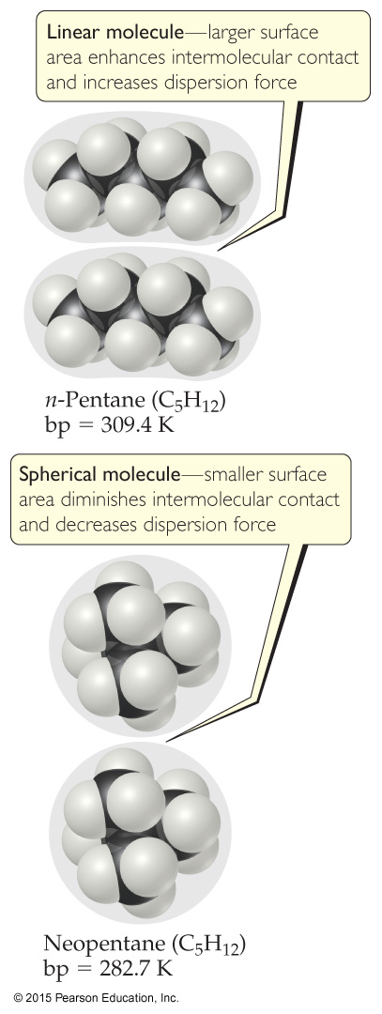
Factors Which Affect Amount of Dispersion Force in a Molecule
number of electrons in an atom (more electrons, more dispersion force)
size of atom or molecule/molecular weight
shape of molecules with similar masses (more contact, larger dispersion force)

Slide 32
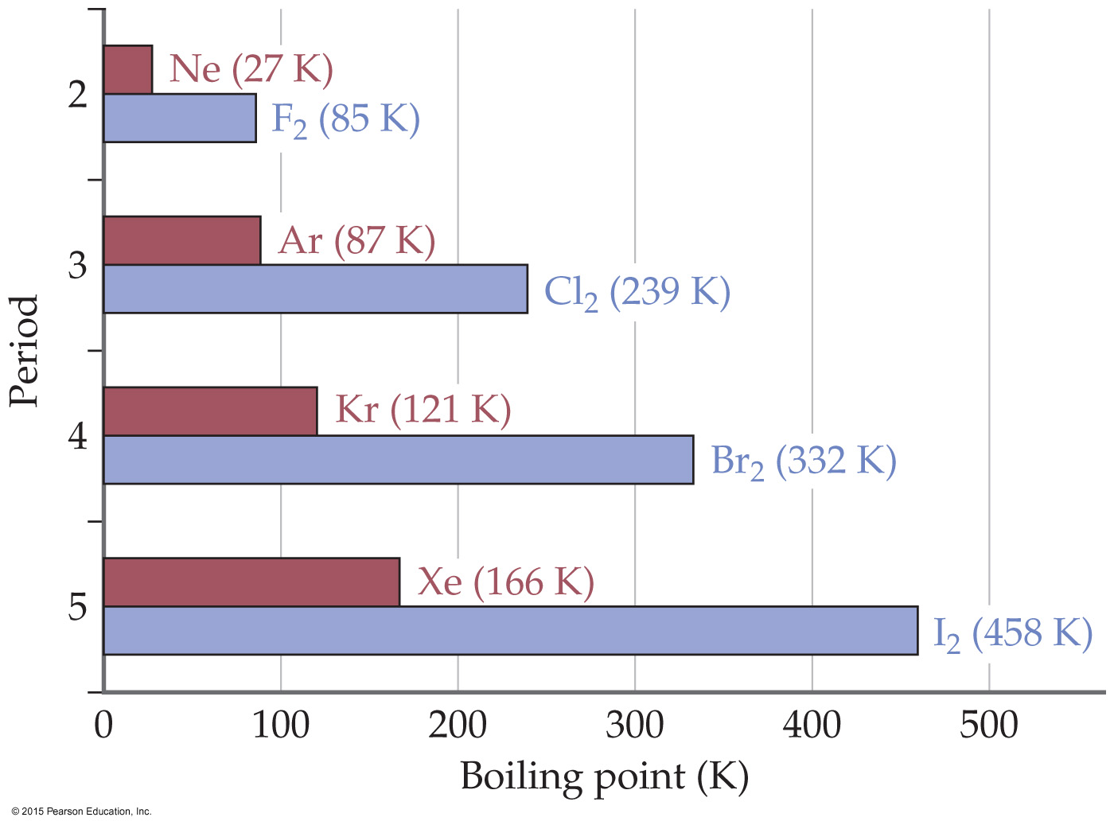
Polarizability & Boiling Point
If something is more difficult to polarize, it has a lower boiling point.
Remember: This means less intermolecular force (smaller molecule: lower molecular weight, fewer electrons).

Slide 33
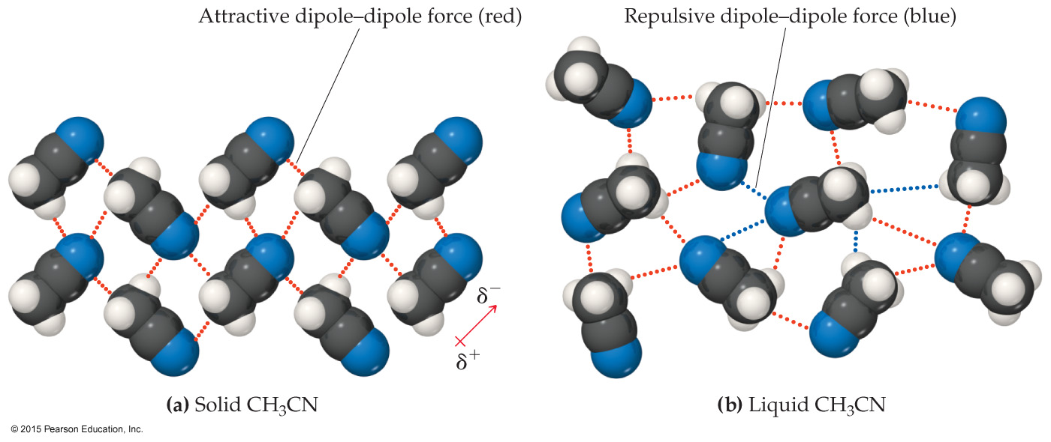
Dipole–Dipole Interactions
Polar molecules have a more positive and a more negative end–a dipole (two poles, δ⁺ and δ⁻).
The oppositely charged ends attract each other.

Slide 34
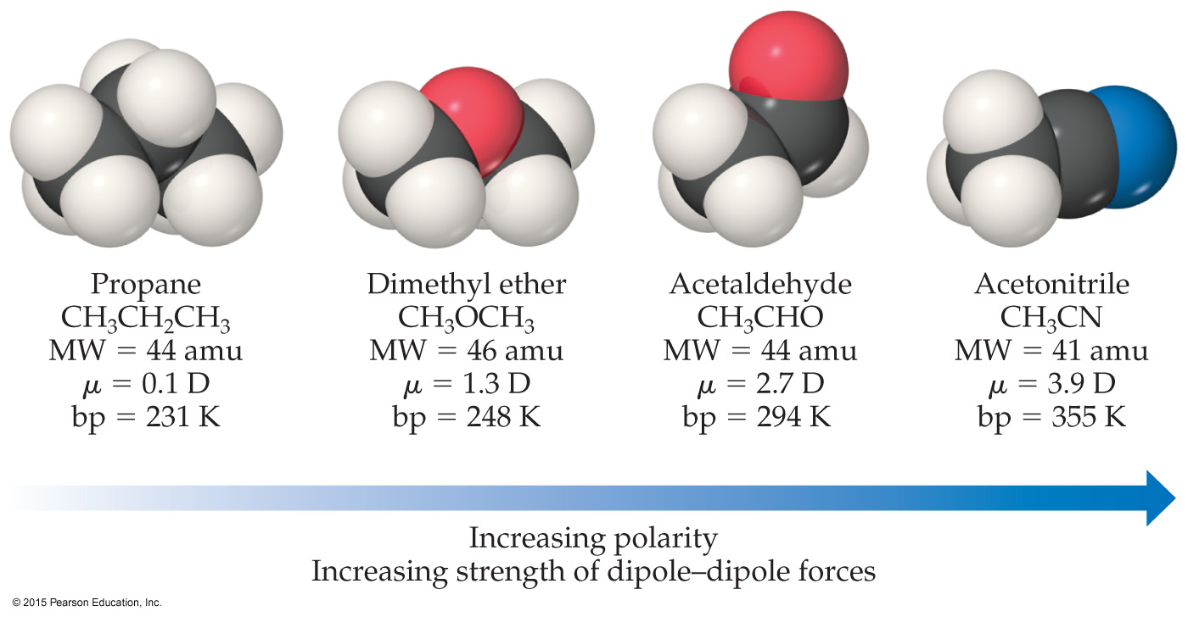
Dipole–Dipole Interactions
For molecules of approximately equal mass and size, the more polar the molecule, the higher its boiling point.

Slide 35
Which Have a Greater Effect: Dipole–Dipole Interactions or Dispersion Forces?
If two molecules are of comparable size and shape, dipole–dipole interactions will likely be the dominating force.
If one molecule is much larger than another, dispersion forces will likely determine its physical properties.

Slide 36
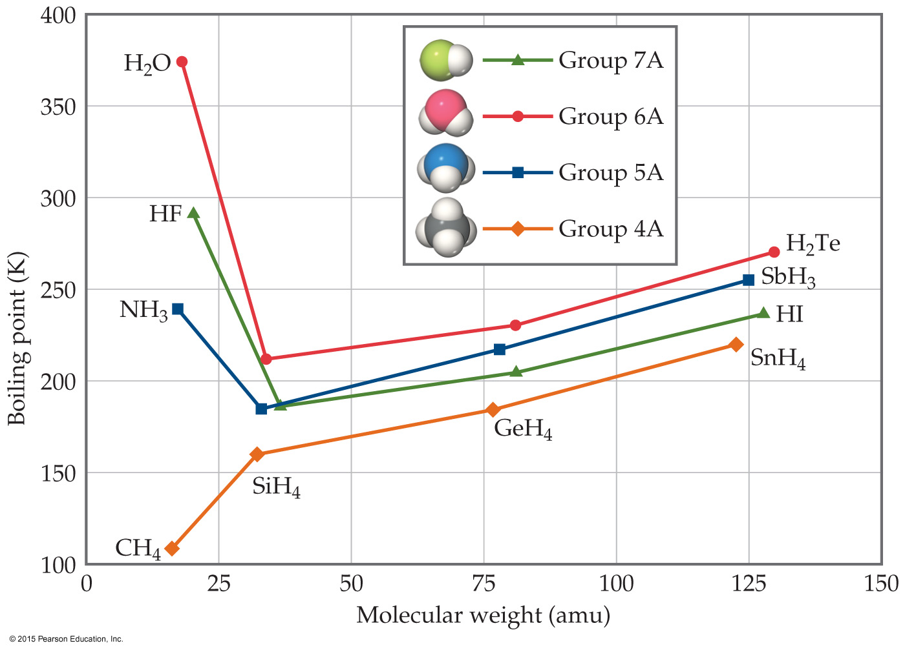
What Does This Graph Show Us?
In a group, the period 3/4/5 elements have higher boiling points as the group member gets larger.
What happens with the period 2 elements? For group 4A, the trend is continued. What about for the other groups?

Slide 37
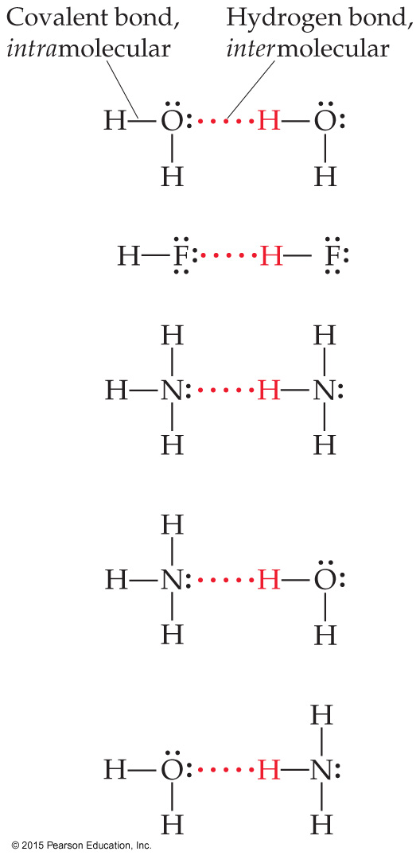
Hydrogen Bonding
The dipole–dipole interactions experienced when H is bonded to N, O, or F are unusually strong.
We call these interactions hydrogen bonds.
A hydrogen bond is an attraction between a hydrogen atom attached to a highly electronegative atom and a nearby small electronegative atom in another molecule or chemical group.

Slide 38
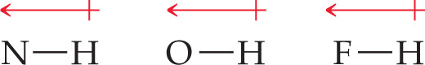
What Forms Hydrogen Bonds?
Hydrogen bonding arises in part from the high electronegativity of nitrogen, oxygen, and fluorine.
These atoms interact with a nearly bare nucleus (which contains one proton).

Slide 39
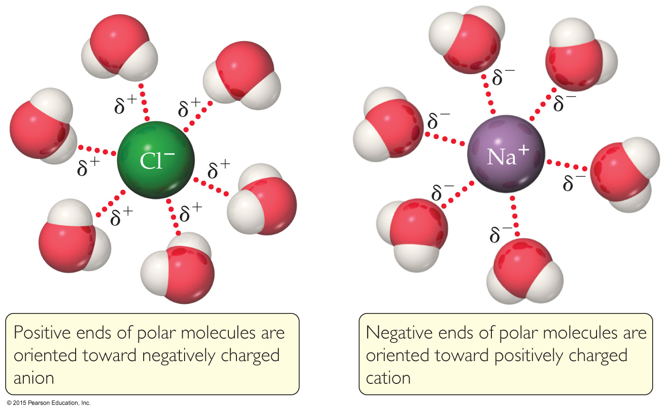
Ion–Dipole Interactions
Ion–dipole interactions are found in solutions of ions.
The strength of these forces is what makes it possible for ionic substances to dissolve in polar solvents.

Slide 40
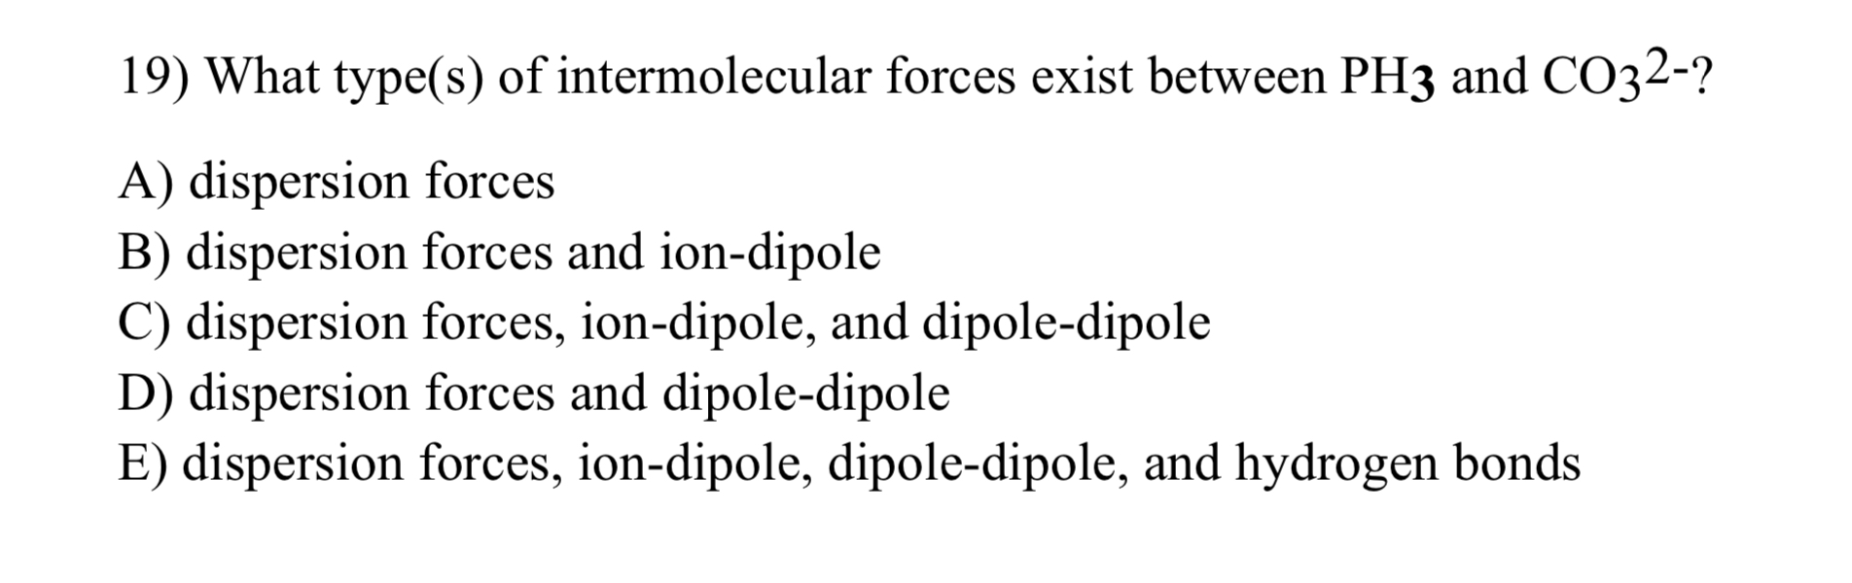

Slide 41
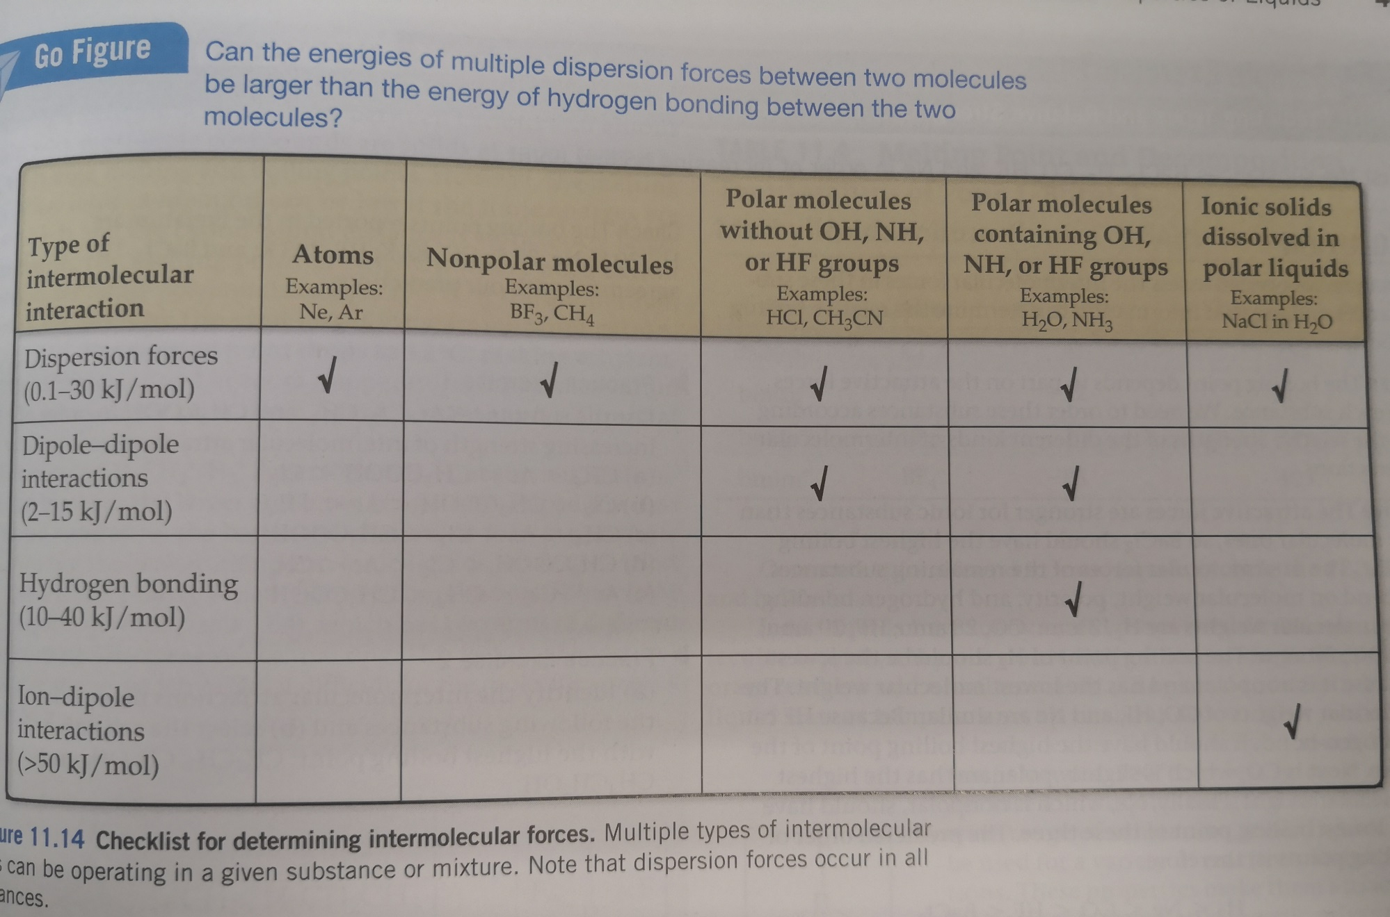
Summarizing Intermolecular Forces

Slide 42
Liquid Properties Affected by Intermolecular Forces
boiling point (previously discussed) and melting point
viscosity
surface tension
capillary action

Slide 43
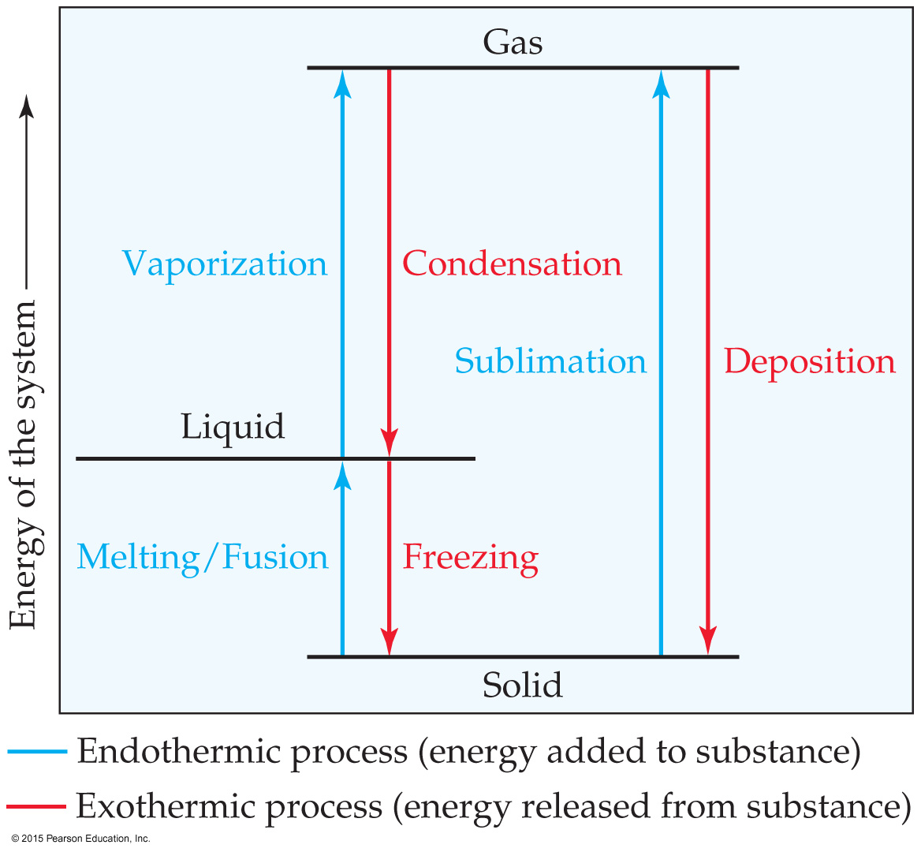
Phase Changes
Conversion from one state of matter to another is called a phase change.
Energy is either added or released in a phase change.
Phase changes: melting/freezing, vaporizing/condensing, subliming/depositing.
Notes:
Start here 6/21/10

Slide 44
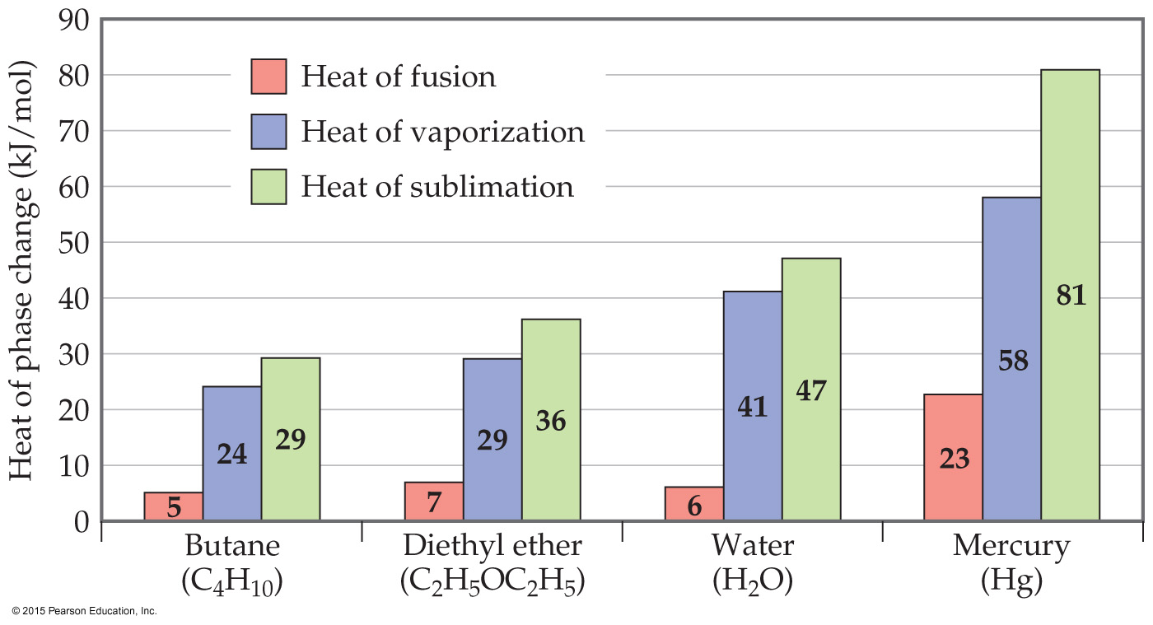
Energy Change & Change of State
The heat of fusion is the energy required to change a solid at its melting point to a liquid.
The heat of vaporization is the energy required to change a liquid at its boiling point to a gas.
The heat of sublimation is the energy required to change a solid directly to a gas.

Slide 45
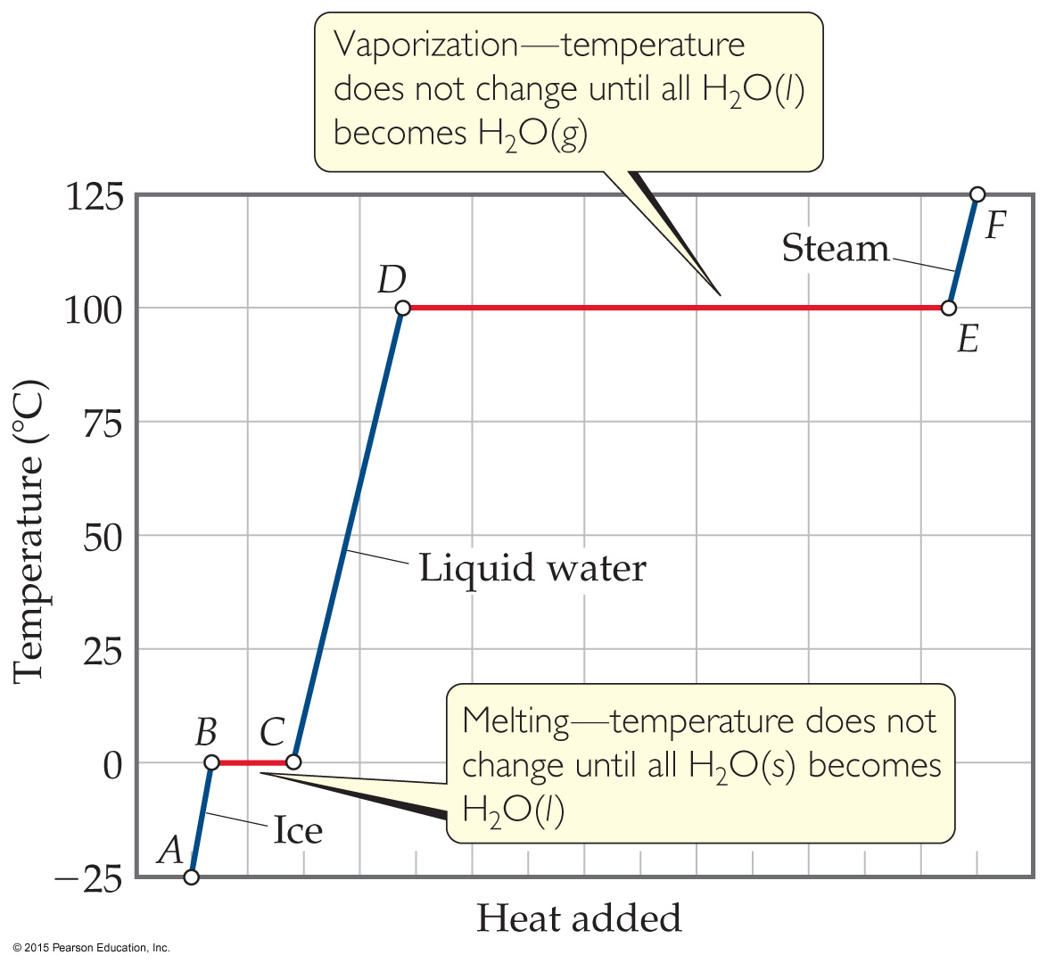
Heating Curves
A plot of temperature vs. heat added is called a heating curve.
Within a phase, heat is the product of specific heat, sample mass, and temperature change.
The temperature of the substance does not rise during a phase change.
For the phase changes, the product of mass and the heat of fusion or of vaporization is heat.

Slide 46
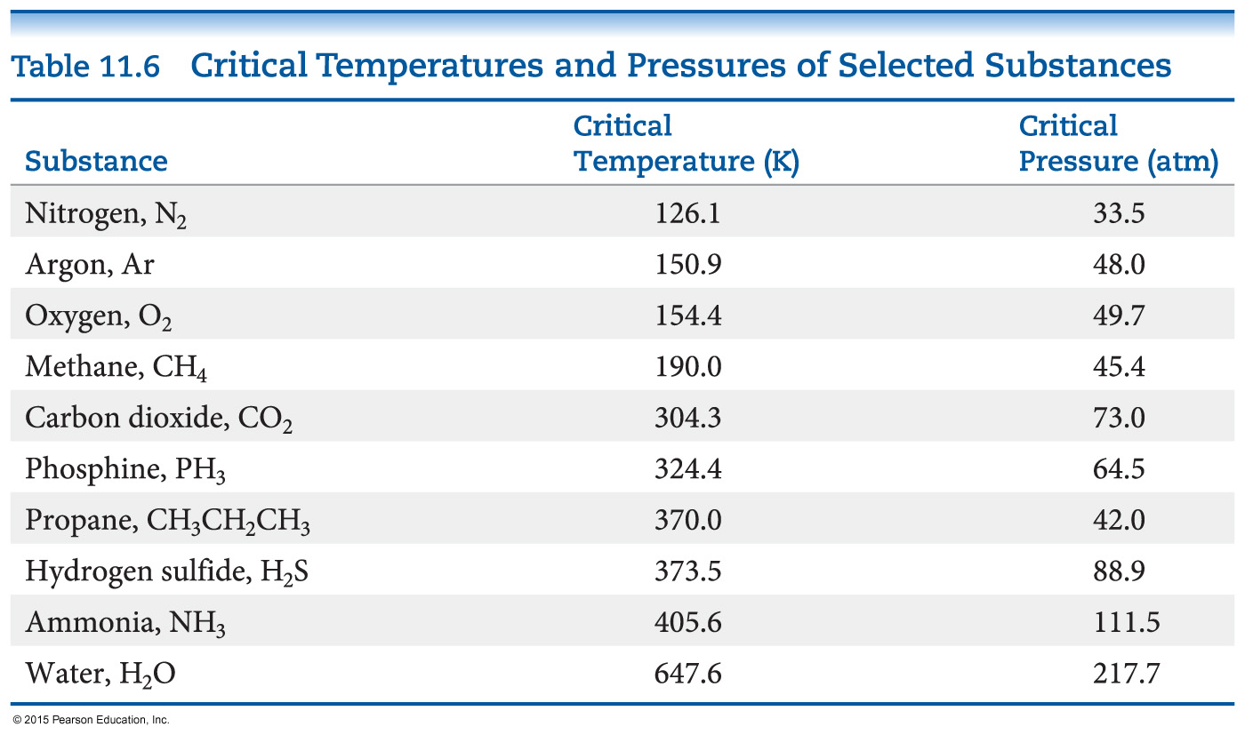
Supercritical Fluids
Gases liquefies when pressure is applied.
The temperature beyond which a gas cannot be compressed is called its critical temperature. The pressure needed to compress the liquid at critical temperature is called critical pressure.
The state beyond this temperature is called a supercritical fluid.

Slide 47
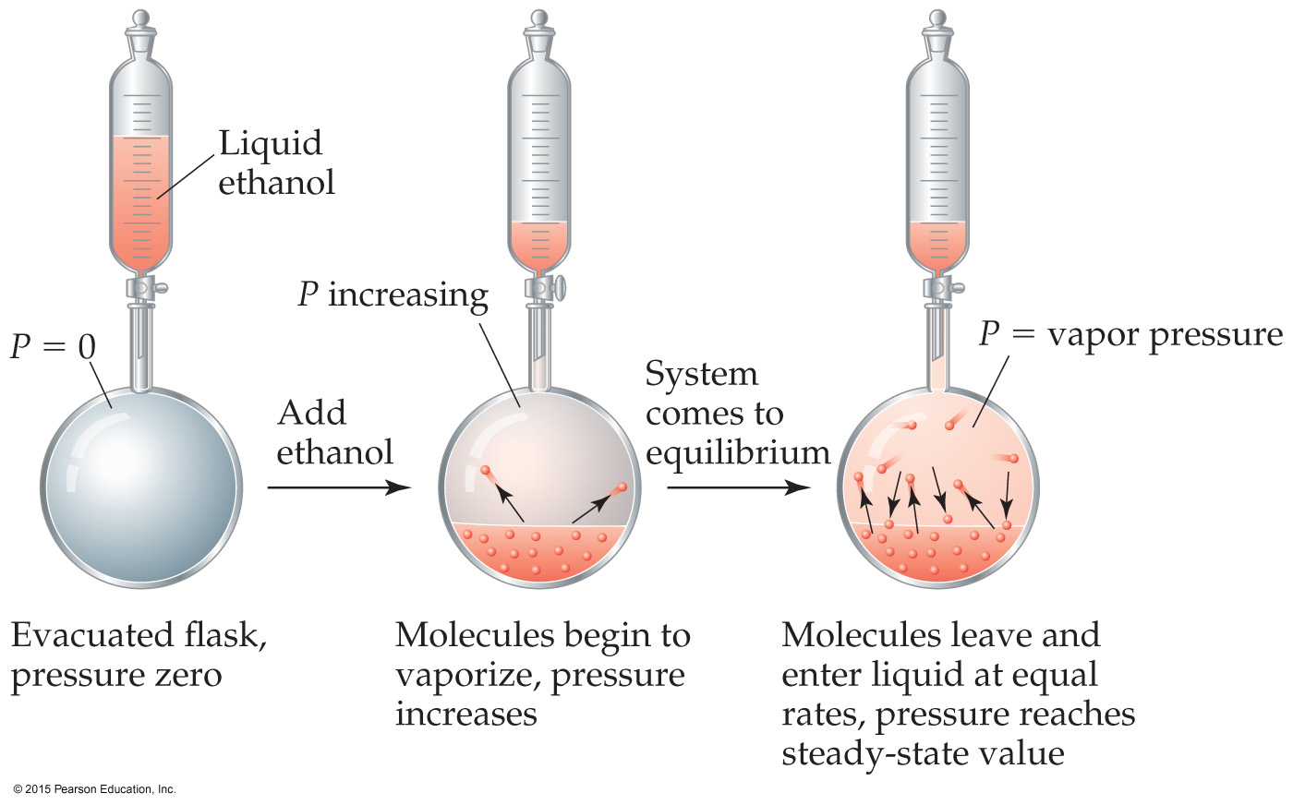
Vapor Pressure
As more molecules escape the liquid, the pressure they exert increases.
The liquid and vapor reach a state of dynamic equilibrium: liquid molecules evaporate and vapor molecules condense at the same rate.

Slide 48
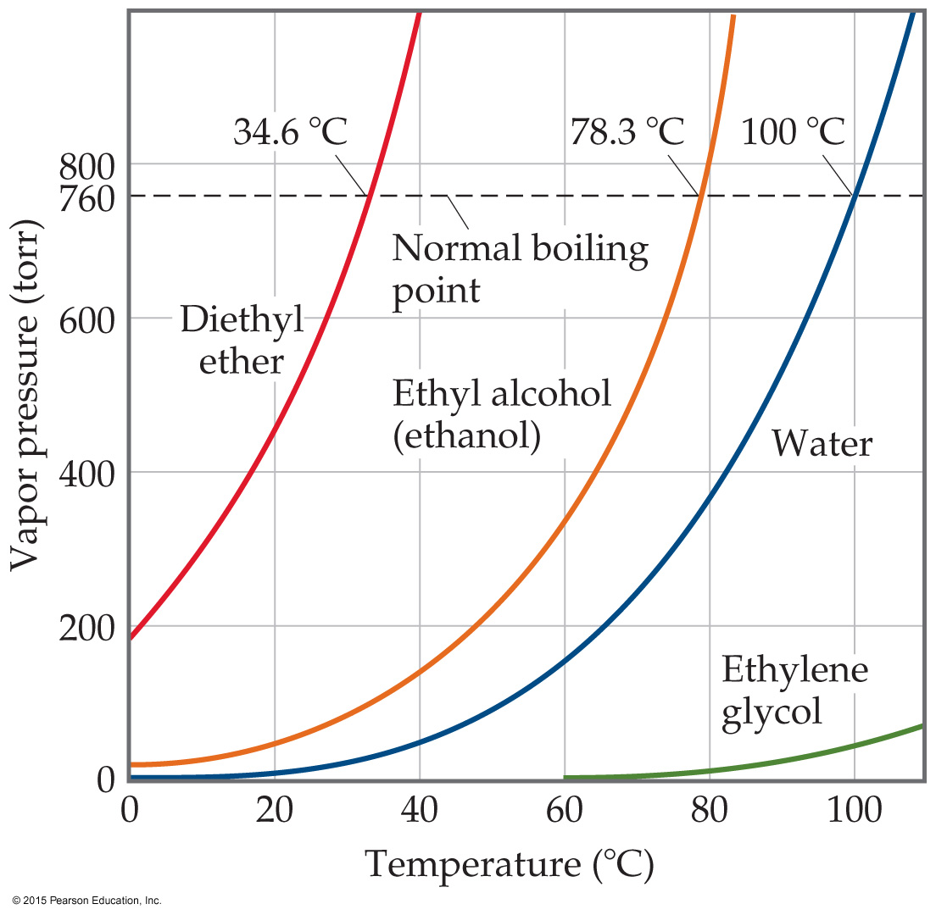
Vapor Pressure
The boiling point of a liquid is the temperature at which its vapor pressure equals atmospheric pressure.
The normal boiling point is the temperature at which its vapor pressure is 760 torr.

Slide 49
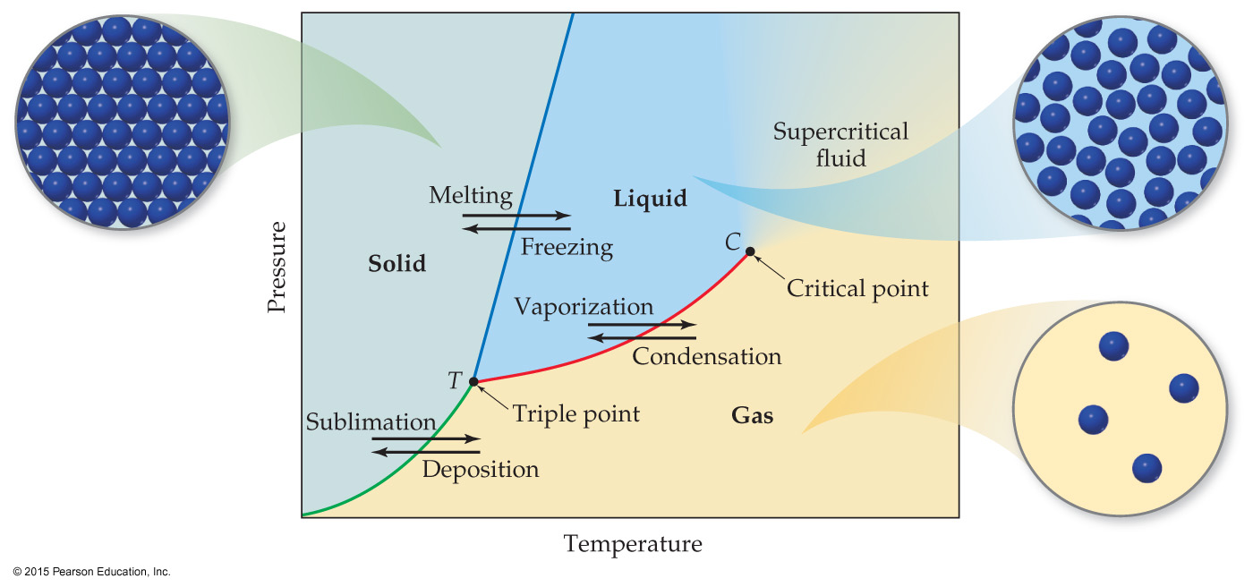
Phase Diagram
A phase diagram is a graph of pressure vs. temperature for a substance. It shows
melting, boiling, and sublimation points at different pressures.
the triple point and critical point.

Slide 50
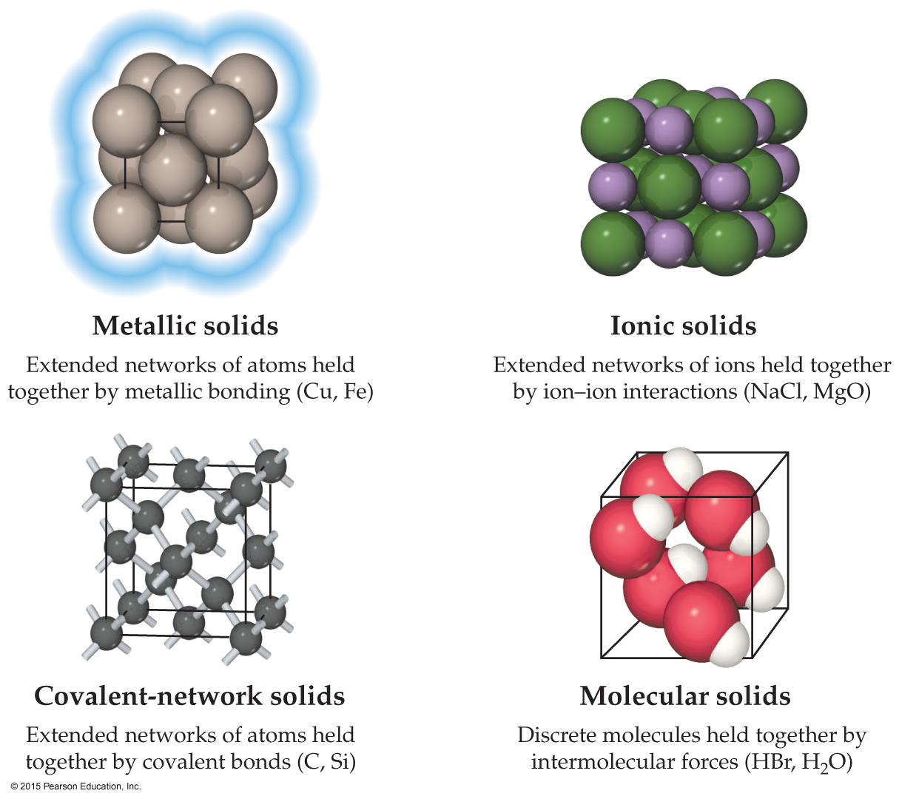
Classifying Solids Based on Bonds
Metallic solids are held together by a “sea” of collectively shared electrons.
Ionic solids are sets of cations and anions mutually attracted to one another.
Covalent-network solids are joined by an extensive network of covalent bonds.
Molecular solids are discrete molecules held together by weak forces.

Slide 51
Two Other Types of Solids
Polymers contain long chains of atoms connected by covalent bonds; the chains can be connected to other chains by weak forces. These molecules have different properties than small molecules or metallic or ionic compounds.
Nanomaterials are crystalline compounds with the crystals on the order of 1–100 nm; this gives them very different properties than larger crystalline materials.

Slide 52
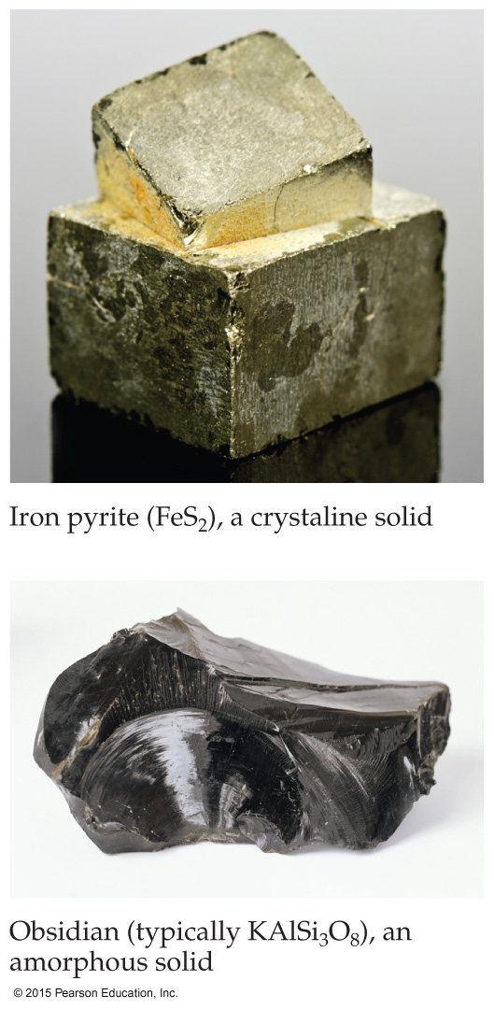
One Organization of Solids
Solids with a regular repeating pattern of atoms are crystalline.
Amorphous solids are characterized by a distinct lack of order in the arrangement of atoms.
Since crystalline solids have a regular pattern, they are of more interest to most chemists.

Slide 53
Unit Cell
The basis of a repeating pattern is the unit cell.
The structure of a crystalline solid is defined by
the size and shape of the unit cell.
the locations of atoms within the unit cell.
Crystal (晶体结构) = lattice(点阵) +motif (基元)

Slide 54
Lattice Points
Positions that define the overall structure of the crystalline compound are called lattice points.
Each lattice point has an identical environment.
Lattice vectors connect the points and define the unit cell.
The next slide shows how this works for five different two-dimensional lattices.

Slide 55
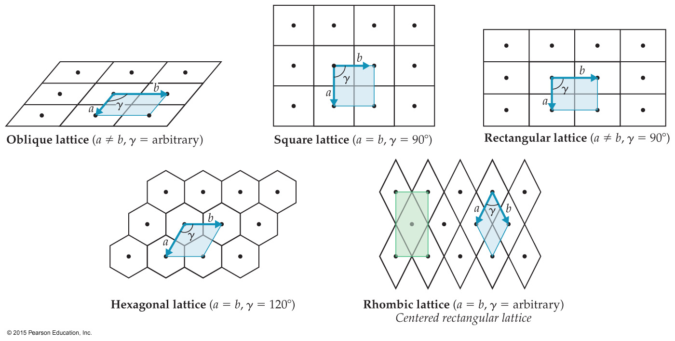
2-D Lattices

Slide 56
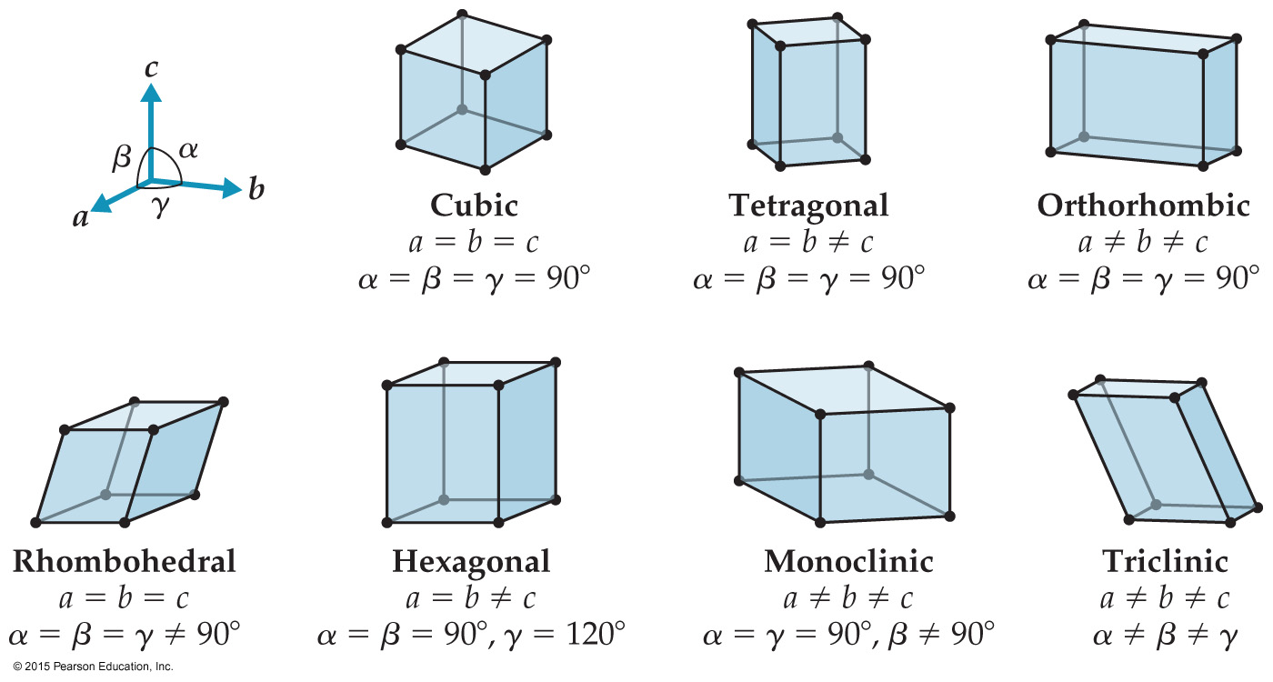
3-D Crystal Lattices
There are seven basic three-dimensional lattices: cubic, tetragonal, orthorhombic, rhombohedral, hexagonal, monoclinic, and triclinic.

Slide 57
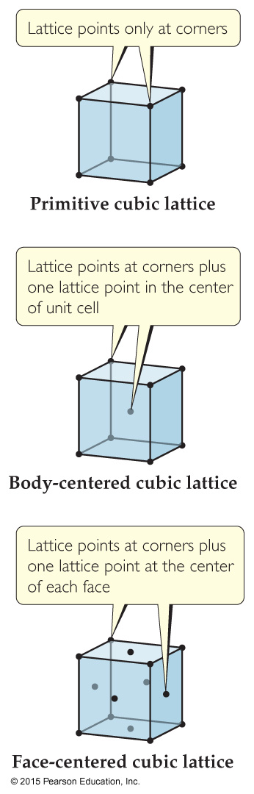
Primitive vs. Centered Lattices
Primitive lattices lattice points at each corner.
Centered lattices has one lattice point at the center (body-center), or has one lattice point at each face (face-center).
Notes:
Just 刚好

Slide 58
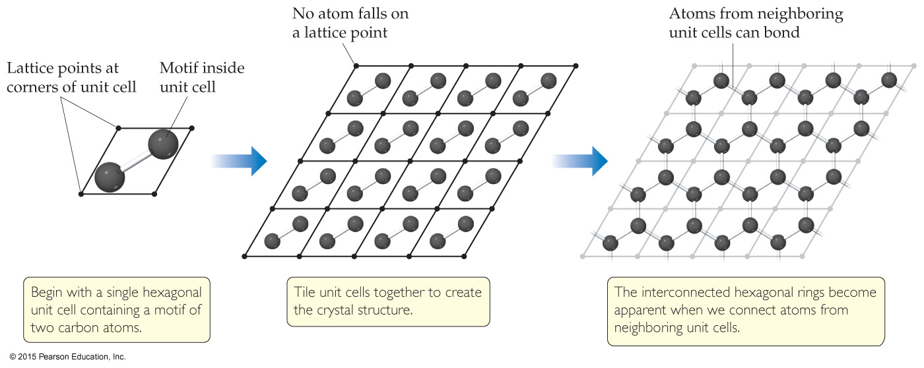
Motifs
Sometimes, the atoms are not on the lattice points, but the overall structure follows a particular unit cell. The groups of atoms that define the overall structure is called a motif.

Slide 59
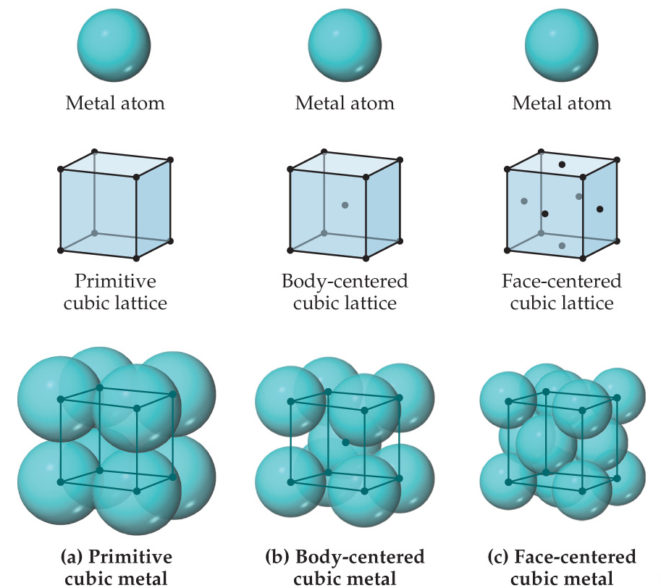
Metallic Structure
The structures of many metals conform to one of the cubic unit cells: simple cubic, body-centered cubic, or face-centered cubic.

Slide 60
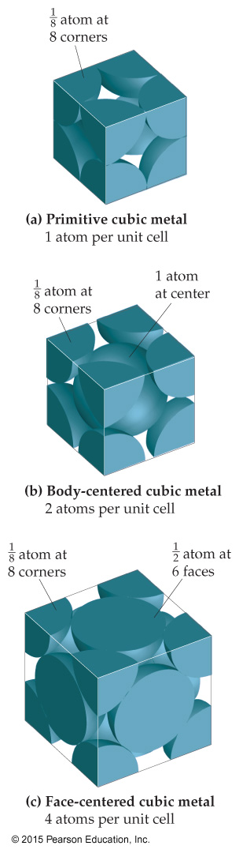
Cubic Structures
Not every part of an atom on a lattice point is completely within that unit cell. One can determine how many atoms are within each unit cell.
Eight cubes meet at a corner, therefore only 1/8 of that corner atom is within any one unit cell meeting there.
Two cubes meet at a face, therefore only 1/2 of that face atom is within any one unit cell meeting there.
A body-centered atom is entirely within the unit cell.

Slide 61
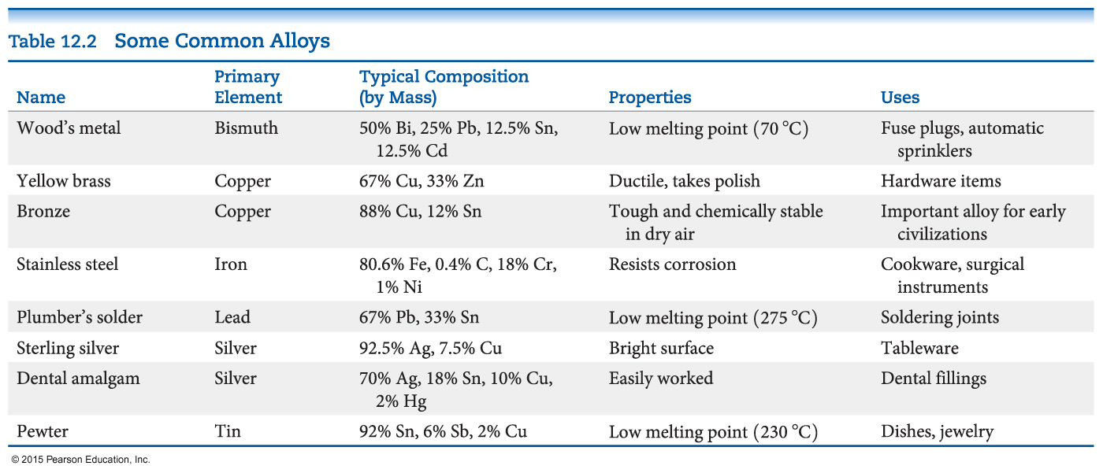
Alloys
Alloys are materials that contain more than one element and have the characteristic properties of metals.
It is an important means employed to change the properties of certain metals.

Slide 62


Types of Alloys
Substitutional alloys: A second element takes the place of a metal atom.
Interstitial alloys: A second element fills a space in the lattice of metal atoms.
Heterogeneous alloys: components not dispersed uniformly
Alloys types: Substitutional alloys, Interstitial alloys, Heterogeneous alloys,
Intermetallic Compounds

Slide 63

Intermetallic Compounds
compounds, not mixtures
distinct properties, definite composition (since they are compounds)
ordered, rather than randomly distributed

Slide 64

Metallic Bonding
One can think of a metal as a group of cations suspended in a sea of electrons.
The electrical and thermal conductivity, ductility, and malleability of metals is explained by this model.

Slide 65

A Molecular-Orbital Approach
As the number of atoms in a chain increases, the energy gap between the bonding orbitals and between the antibonding orbitals disappears, resulting in a continuous band of energy. The approach seen here only takes into account s-orbital population.

Slide 66

MO Approach with More Orbitals
Most metals have d and p orbitals to consider.
Their MO diagrams lead to more bands that better explain conductivity and other properties of metals.

Slide 67

Ionic Solids
In ionic solids, the lattice comprises alternately charged ions.
Ionic solids have very high melting and boiling points and are quintessential crystals.

Slide 68

Ionic Solids
Most favorable structures have cation–anion distances as close as possible, but the anion–anion and cation–cation distances are maximized.
Three common structures for 1:1 salts:
CsCl structure
NaCl (rock salt) structure
zinc blende (ZnS) structure

Slide 69

Effect of Ion Size on Structure
The size of the cation compared to the anion (radius ratio) is the major factor in which structure is seen for ionic compounds.

Slide 70

Molecular Solids
Consist of atoms or molecules held together by weaker forces (dispersion, dipole–dipole, or hydrogen bonds).
Shape (ability to stack) matters for some physical properties, like boiling point.
Notes:
Melting point---intermolecular packing is weaker; boiling point: intermolecular attractive force of toluene is larger

Slide 71


Covalent-Network Solids
Atoms are covalently bonded over large network distances with regular patterns of atoms.
Tend to have higher melting and boiling points.
Diamond is an example.

Slide 72

Semiconductors
They have a gap between the occupied MOs (valence band) and the unoccupied ones (conduction band).
Electrons must enter the conduction band for electron transfer.
Group IVA elements have gaps between the bands of 0.08 to 3.05 eV (7 to 300 kJ/mol).
Note: Band gaps over 3.5 eV lead to the material being an insulator.

Slide 73

What Forms a Semiconductor?
Among elements, only Group IVA, all of which have 4 valence electrons, are semiconductors.
Inorganic semiconductors (like GaAs) tend to have an average of 4 valence electrons (3 for Ga, 5 for As).

Slide 74



